Slide 1
Microsoft Movie studio
Yvonne Mwangi
Phase 1 Project

Slide 2

Agenda
1.
Introduction
2.
Data Analysis
3.
4.
Findings
Recommendations

Slide 3
Introduction - Problem statement
Microsoft have decided to create a new movie studio.
I have been charged with exploring what types of films are currently doing the best at the box office.
My task is to translate those findings into actionable insights that the head of Microsoft's new movie studio can use to help decide what type of films to create.

Slide 4
Data Analysis – Data source
The data used in this analysis is from movie datasets from the following sources:
Box Office Mojo
IMDB
Rotten Tomatoes
TheMovieDB and
The Number

Slide 5
Data Analysis - Data set limitations
Pros
Sufficiently large data sets
Varied information to allow various analysis
Cons
A great number of duplicates due after merging tables
Missing data in some of the data sets.
Discrepancies in some of the data sets for instance finding a movie with two different tconst ids

Slide 6
Data Analysis – Data source
The data set contains movies created between 2010 and 2019.
The average length of the movies is 105 minutes. The longest movie is 192 minutes.
The average rating of these movies is 6.4. The lowest rating is 1.6 while the highest rating is 9.2.
The average budget for production of the movies is USD 4.66M. The lowest budget is USD 100000, while highest bud get is USD 3.79M
The average revenue for the movies is USD 1.58B . There are movies that did not generate revenue , while the one with the highest revenue is USD 2.04B

Slide 7
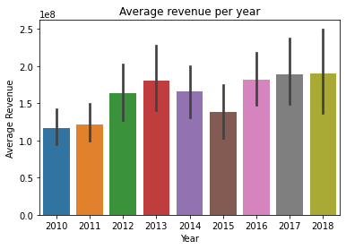
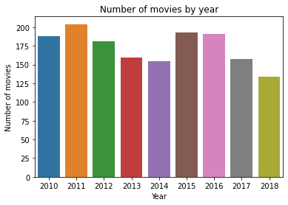
Findings
Average revenue $ 1.58B
Average number of movies per year – 173

Slide 8
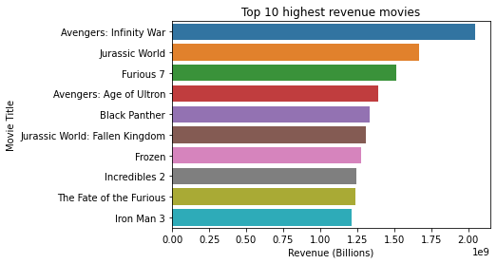
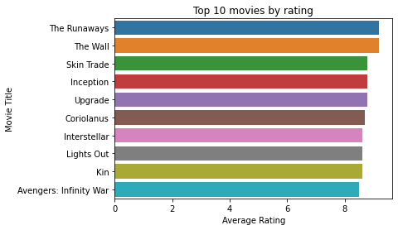

Findings – Top movies
The Avengers movies was both highly rated and generated high revenue

Slide 9
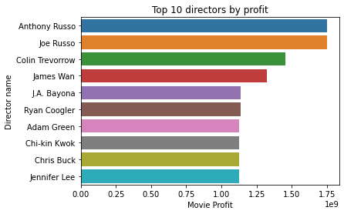
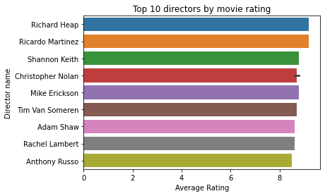
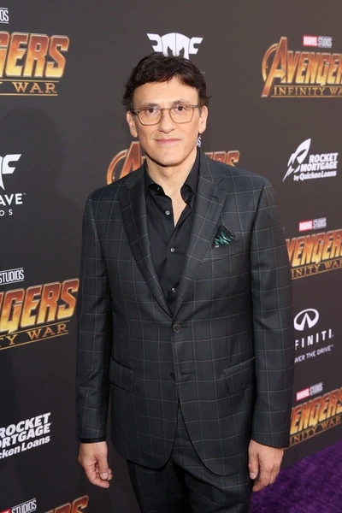
Findings – Top directors
Anthony Russo is a highly rated producer whose movies are profitable

Slide 10
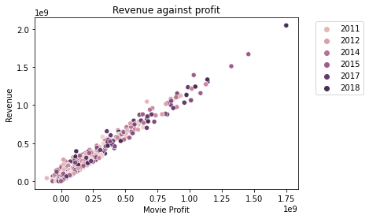
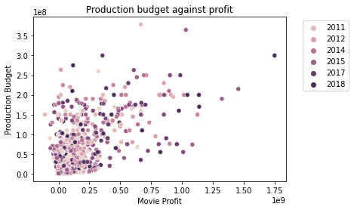
Findings
The revenue and profitability of movies are positively correlated.
The production budget does not have a linear relationship with the profitability of the movie

Slide 11
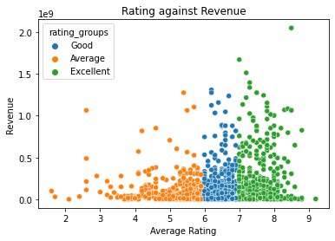
Findings
A higher rating does not necessarily translate to a higher revenue however more movies with a higher revenue had a rating of 6 and above
Rating only do not predict the success of a movie

Slide 12
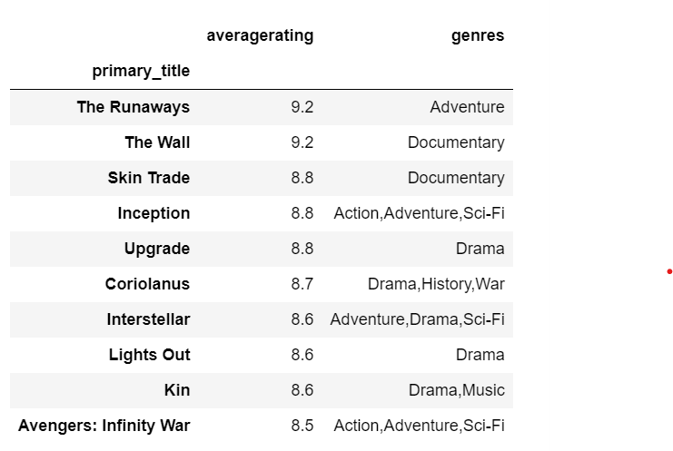
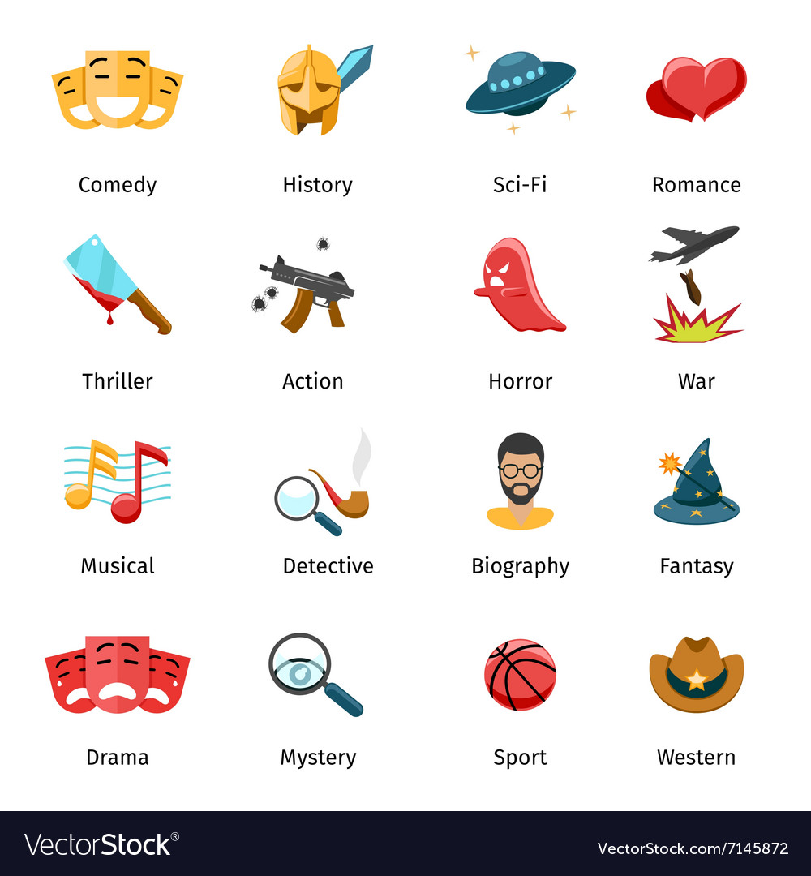
Findings - Genres
Adventure and Drama movies are popular

Slide 13
Recommendations
I advise Microsoft to pick the top directors Anthony Russo and Joe Russo. Since they are highly rated and they produce successful movies in revenue.
They would be a great option to start off the Microsoft studio and advise in matters of choices of the genres to focus on and actors to consider.
Adventure and Drama genres are popular genres to consider
Movie business is profitable
With the right choice of directors, Microsoft will succeed in this venture

Slide 14


